Slide 1
Northern blotting

Slide 2
Northern blot
A northern blot is a laboratory method used to detect specific RNA molecules among a mixture of RNA. Northern blotting can be used to analyze a sample of RNA from a particular tissue or cell type in order to measure the RNA expression of particular genes. This method was named for its similarity to the technique known as a Southern blot.
The first step in a northern blot is to denature, or separate, the RNA within the sample into single strands, which ensures that the strands are unfolded and that there is no bonding between strands. The RNA molecules are then separated according to their sizes using a method called gel electrophoresis. Following separation, the RNA is transferred from the gel onto a blotting membrane. (Although this step is what gives the technique the name "northern blotting," the term is typically used to describe the entire procedure.) Once the transfer is complete, the blotting membrane carries all of the RNA bands originally on the gel. Next, the membrane is treated with a small piece of DNA or RNA called a probe, which has been designed to have a sequence that is complementary to a particular RNA sequence in the sample; this allows the probe to hybridize, or bind, to a specific RNA fragment on the membrane. In addition, the probe has a label, which is typically a radioactive atom or a fluorescent dye. Thus, following hybridization, the probe permits the RNA molecule of interest to be detected from among the many different RNA molecules on the membrane.

Slide 3
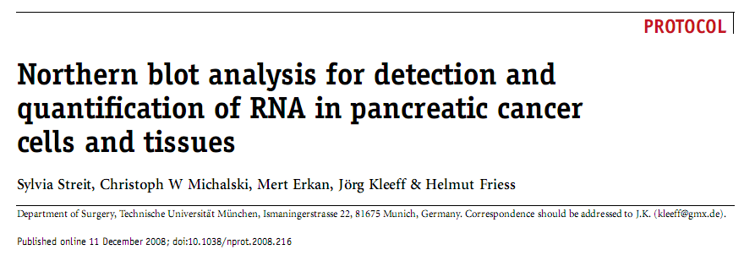

Slide 5
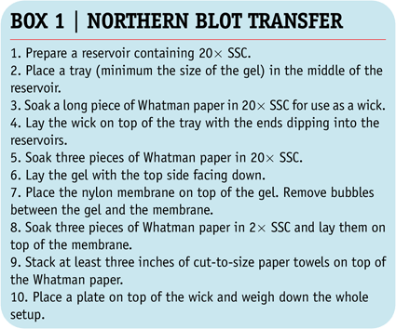
Northern blot analysis for detection and quantification of RNA in pancreatic cancer cells and tissues

Slide 6
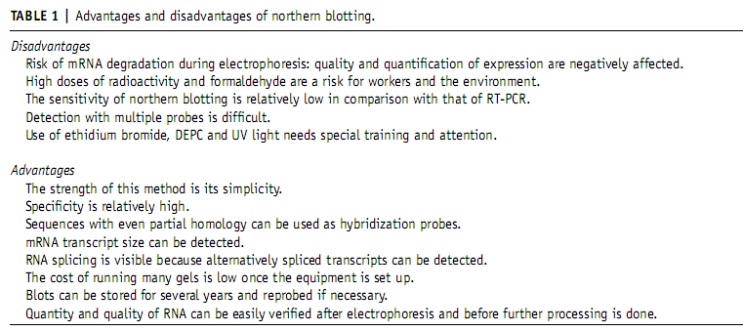

Slide 7
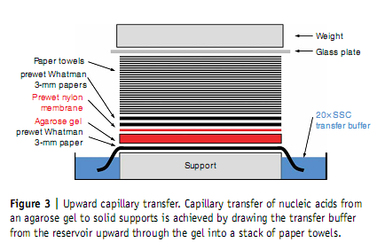

Slide 8
